Slide 1
Scikits Iowa Alcohol Distributors - Machine Learning Project
AMIL WALGAMAGE, JAMIE TAN & TAS TUDOR

Slide 2

PROJECT SUMMARY
Proposed Solution
High Level:
Machine Learning Product Recommender for wholesale liquor outlets in Iowa USA.
Successfully Completed:
Built and deployed working machine learning website based on data obtained from Google's machine learning public databases.

Slide 3
THE DATA
Something
Something
Something

Slide 4
MACHINE LEARNING
TURICREATE
9 models

Slide 5
MACHINE LEARNING
The Learning Model
Some stuff about Turicreate

Slide 7
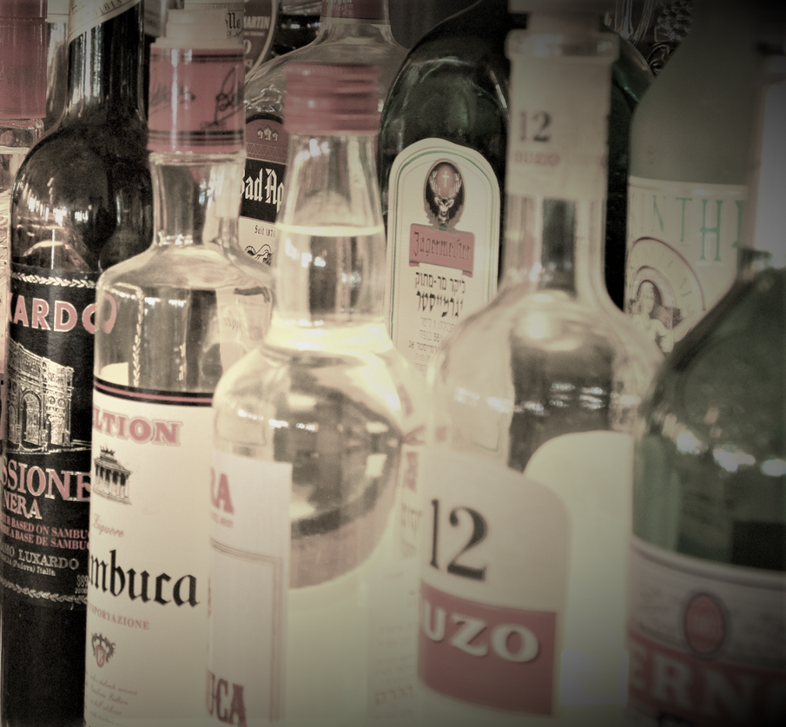
PROJECT SUMMARY
Proposed Solution
High Level: Machine Learning Product Recommender for wholesale liquor outlets in Iowa USA.
Completed: Built and deployed working machine learning website based on data obtained from Google's machine learning public databases.

Slide 8
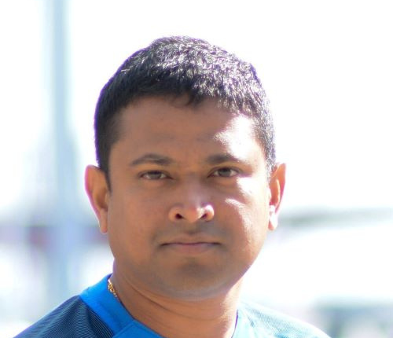
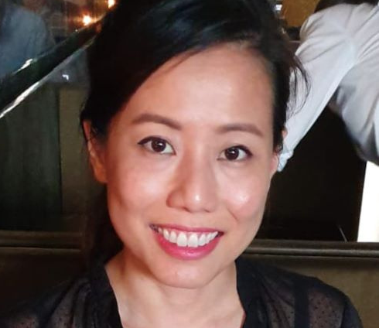
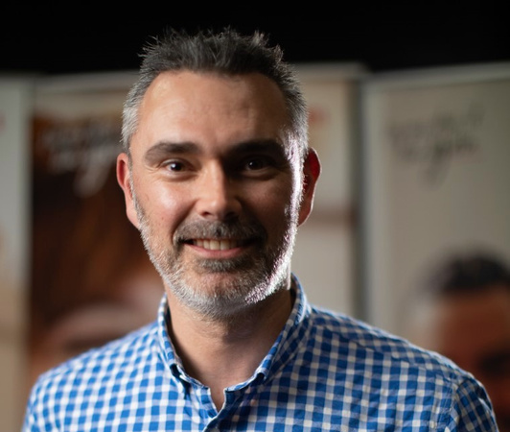
THE TEAM
Amil Walgamage
Jamie Tan
Tas Tudor

